Slide 1
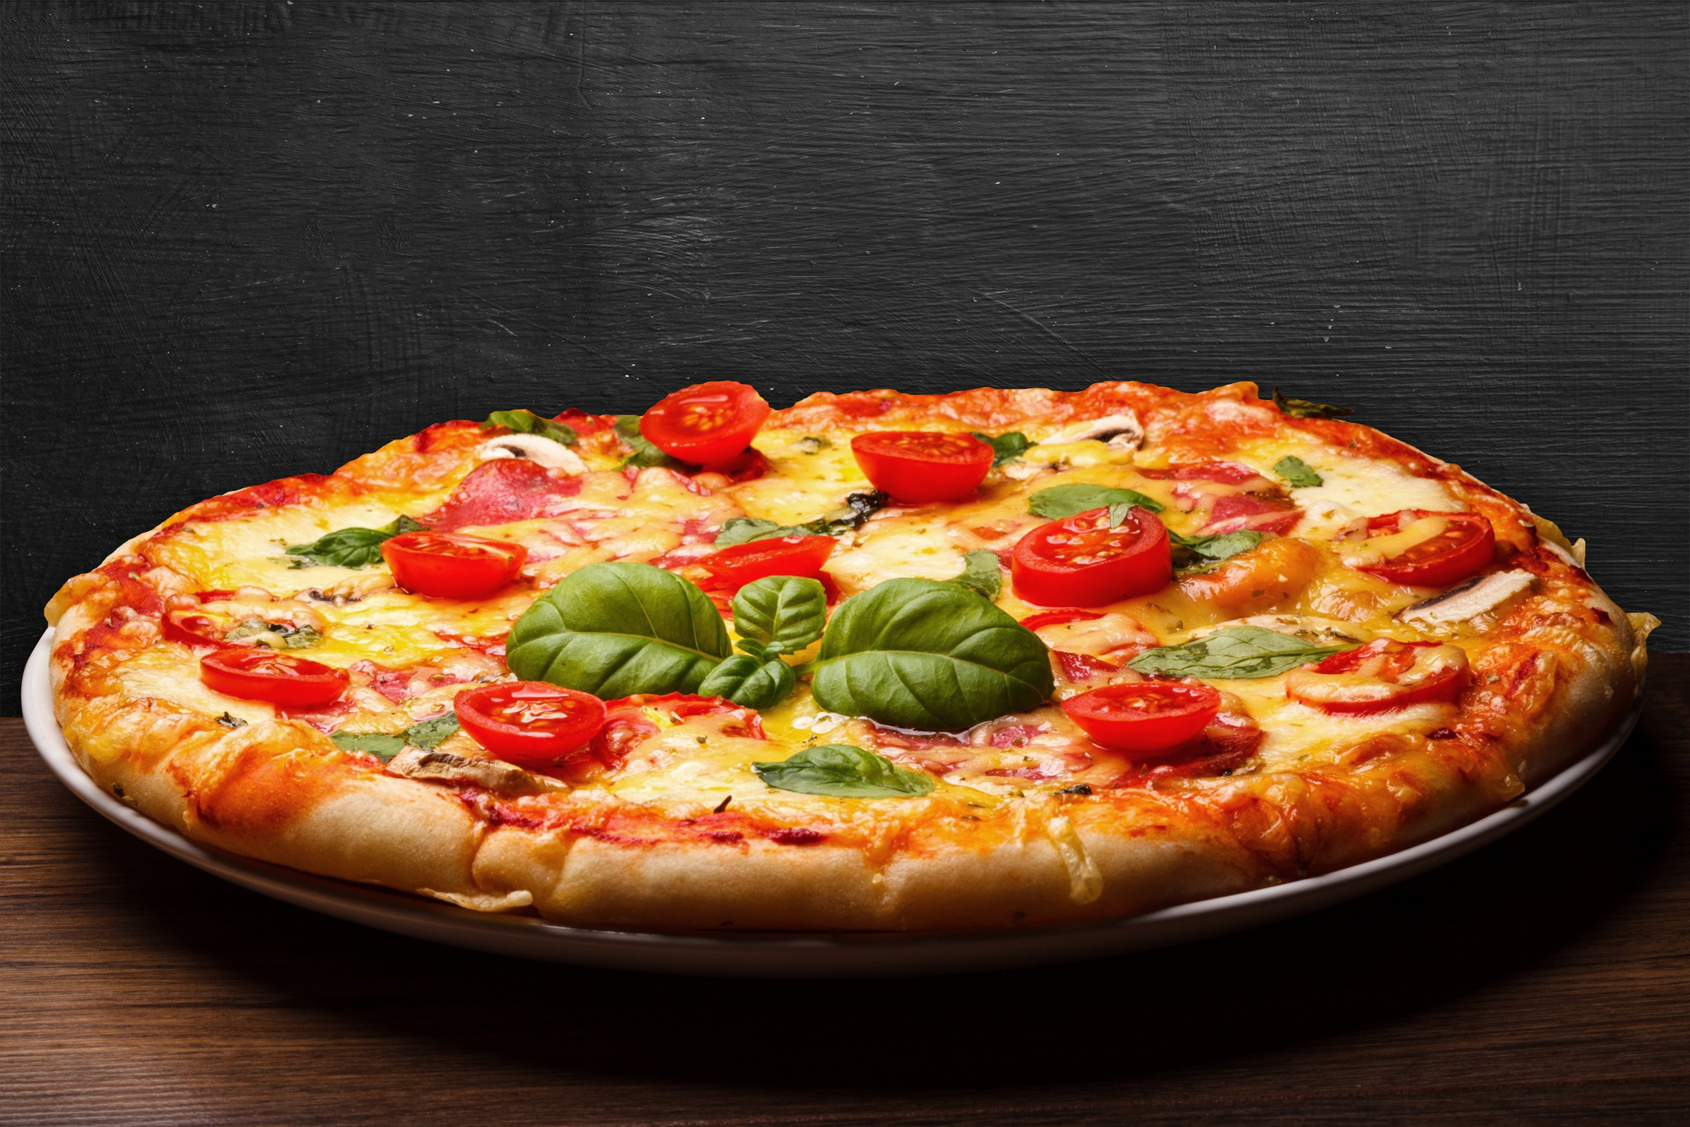

PIZZA SALES ANALYSIS USING SQL
by DEEPAK YADAV

Slide 2


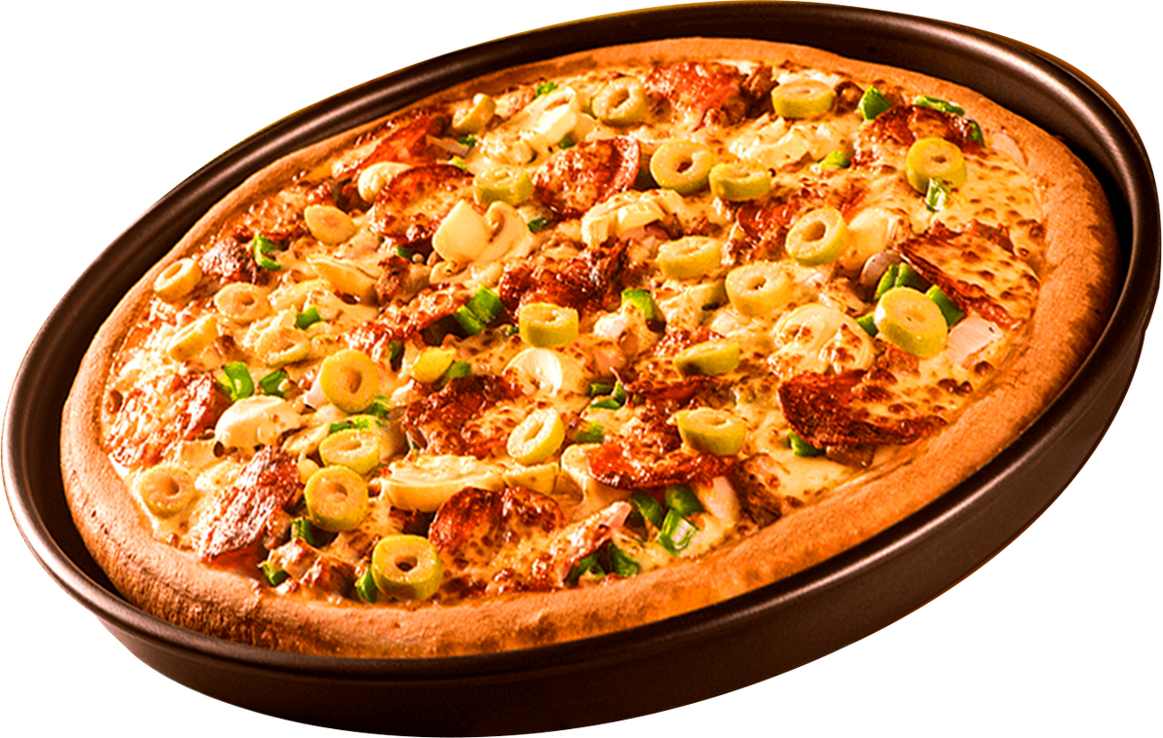

Hello !
Hello everyone, my name is Deepak Yadav.
In this project, I have used SQL queries to analyze and solve various questions related to pizza sales.
The goal is to extract meaningful insights from the data — such as sales performance, popular pizza types, revenue trends, and customer preferences — using structured and well-organized queries.
Tools Used: MySQL
Data Source: Sample pizza sales dataset
Focus: Covering basic, intermediate, and advanced SQL queries

Slide 3
SQL QUERY CLASSIFICATION – PIZZA SALES ANALYSIS
🟩 Basic Queries
Retrieve the total number of orders placed
Calculate the total revenue generated from pizza sales
Identify the highest-priced pizza
Identify the most common pizza size ordered
🟨 Intermediate Queries
Determine distribution of orders by hour of the day
Find category-wise distribution of pizzas
Group orders by date and calculate average pizzas per day
Determine top 3 most ordered pizzas based on revenue

Slide 4
SQL QUERY CLASSIFICATION – PIZZA SALES ANALYSIS
🟥 Advanced Queries
Calculate percentage contribution of each pizza type to total revenue
Analyze cumulative revenue generated over time
Find top 3 most ordered pizza types by revenue for each category
These queries progressively analyze sales performance, customer preferences, and revenue distribution using SQL joins, aggregation, and window functions.

Slide 5
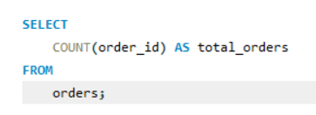
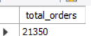
Basic Queries 🔹
-- Retrieve the total number of orders placed

Slide 6
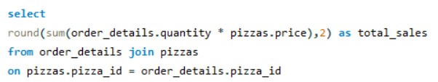
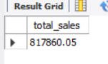
Basic Queries 🔹
–- Calculate the total revenue generated from pizza sales

Slide 7
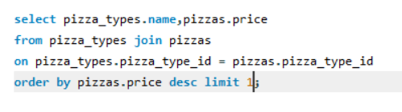
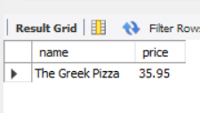
Basic Queries 🔹
–- Identify the highest-priced pizza

Slide 8
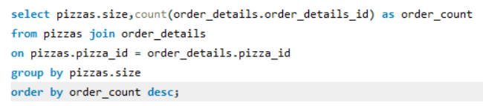
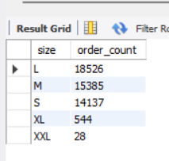
Basic Queries 🔹
–- Identify the most common pizza size ordered

Slide 9
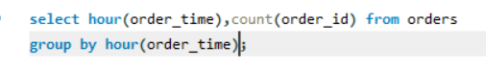
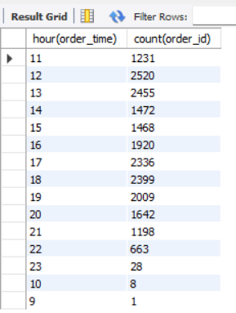
Intermediate Queries
-- Determine distribution of orders by hour of the day

Slide 10
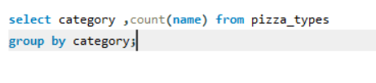
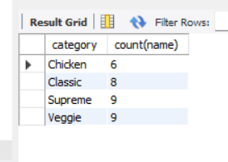
Intermediate Queries
-- Join relevant tables to find the category-wise distribution of pizzas.

Slide 11
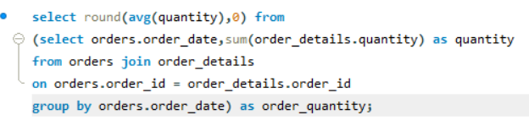
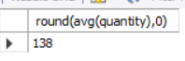
Intermediate Queries
–- Group orders by date and calculate average pizzas per day

Slide 12
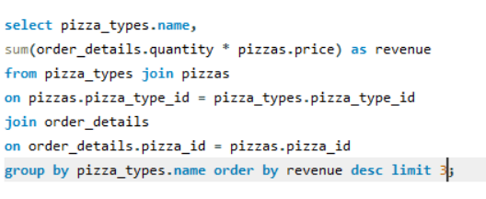
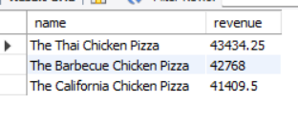
Intermediate Queries
–- Determine top 3 most ordered pizzas based on revenue

Slide 13
📊 Conclusion – Key Business Insights from Pizza Sales Analysis
✅ Sales Volume & Revenue: The analysis highlighted the total order volume and revenue, helping understand the business's scale and performance.
🍕 Customer Preferences: Medium-sized pizzas were the most popular, indicating strong customer preference that can guide inventory and marketing decisions.
🕒 Peak Business Hours: Most orders were concentrated during specific hours of the day, providing opportunities to optimize staffing and delivery operations.
💸 Top Revenue Contributors: A few pizzas contributed the majority of sales, which can be promoted further to boost revenue.
📈 Advanced Revenue Trends: Cumulative and category-wise revenue tracking revealed which pizza types consistently perform well over time.
🎯 Business Application: These insights enable better decision-making in pricing, promotions, menu design, and resource planning.

